Slide 1
Statistics Lab 5
Shir Tsarfaty
Ido Ravid
Omer Sutovsky

Slide 2
Goals for this lab
G+C_content ~ reads or G_content~reads /C_content~reads enough?
Mapping GC explainability along chromosome
Optimal bin size for model
Exploring Poisson and Pseudo-Poisson GLM models
AI-First lab experience

Slide 3
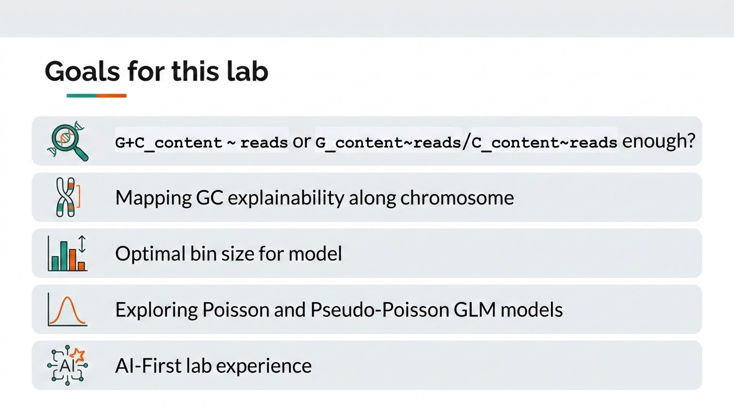

Slide 4
Metrics & Estimators selected - Reminder from Lab4
R²: explained variation / goodness of fit
Spearman correlation: robust monotonic relationship
Spearman(X,Y)=Pearson(rank(X),rank(Y))
IQR / median error: robust typical spread of residuals
VMR / φ: checks Poisson overdispersion

Slide 5
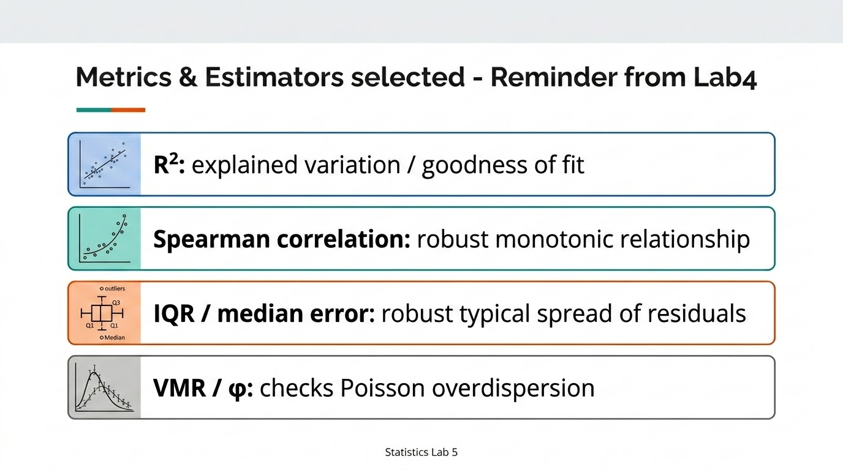

Slide 6
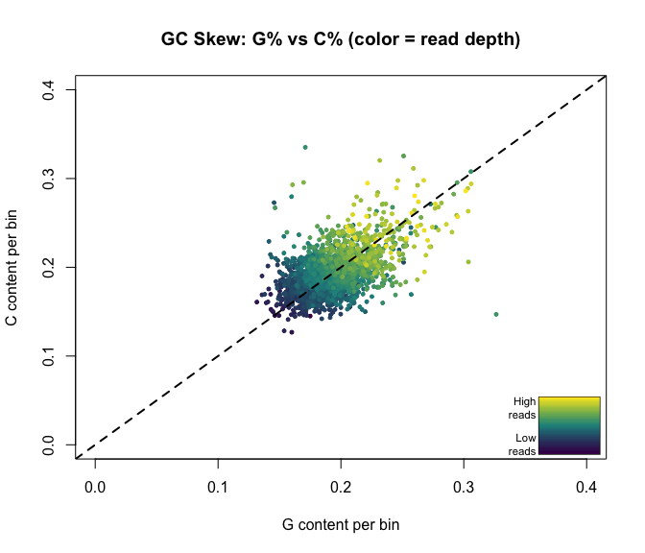
Predicting Using G, C & G+C
Model | R² | Spearman | Median Absolute Error
G Alone | 0.5267 | 0.7621 | 21.18
C Alone | 0.5299 | 0.7551 | 21.76
G+C | 0.6973 | 0.8897 | 14.03

Slide 7
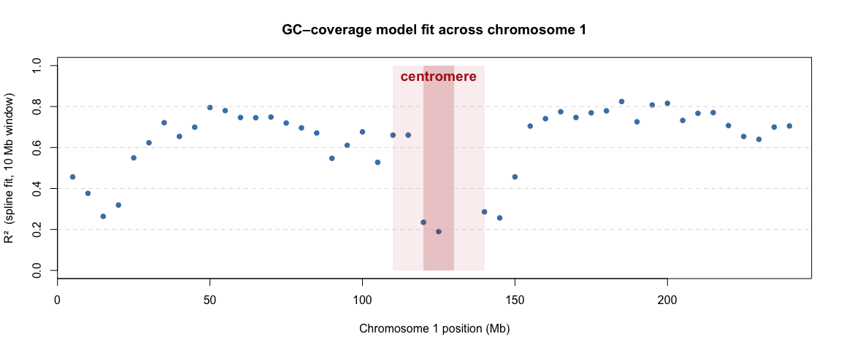
B. GC explainability along chromosome
Shiny App Port Link
Notes:
To run, follow these instructions:
One-time setup (if on a new machine):
cd /path/to/StatisticsLab
git pull
Rscript -e "install.packages(c('shiny','data.table','splines','plotly'), repos='https://cloud.r-project.org')"
Every time you want to run it:
cd /Users/idoravid/Documents/Studies/Stat\ Lab/StatisticsLab
Rscript -e "shiny::runApp('lab5/shiny_app')"
Then open http://127.0.0.1:3838 in your browser.
Expected startup output:
[1/6] Reading reads file...
[2/6] Loading chromosome sequence...
[3/6] Loading precomputed cache... ← instant, no recomputing
-> cache loaded instantly!
[6/6] All precomputation done — app ready!
Listening on http://127.0.0.1:3838
To stop it: Ctrl+C in the terminal.

Slide 8
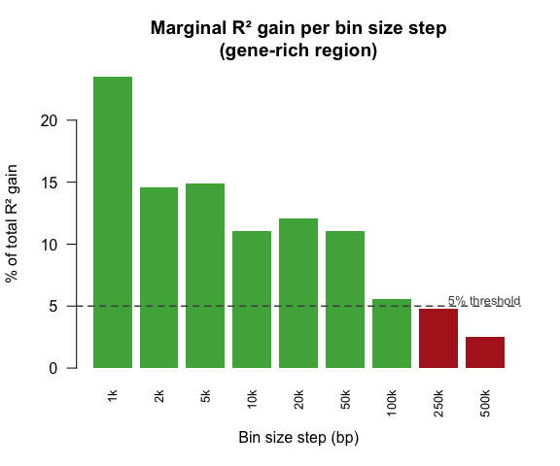
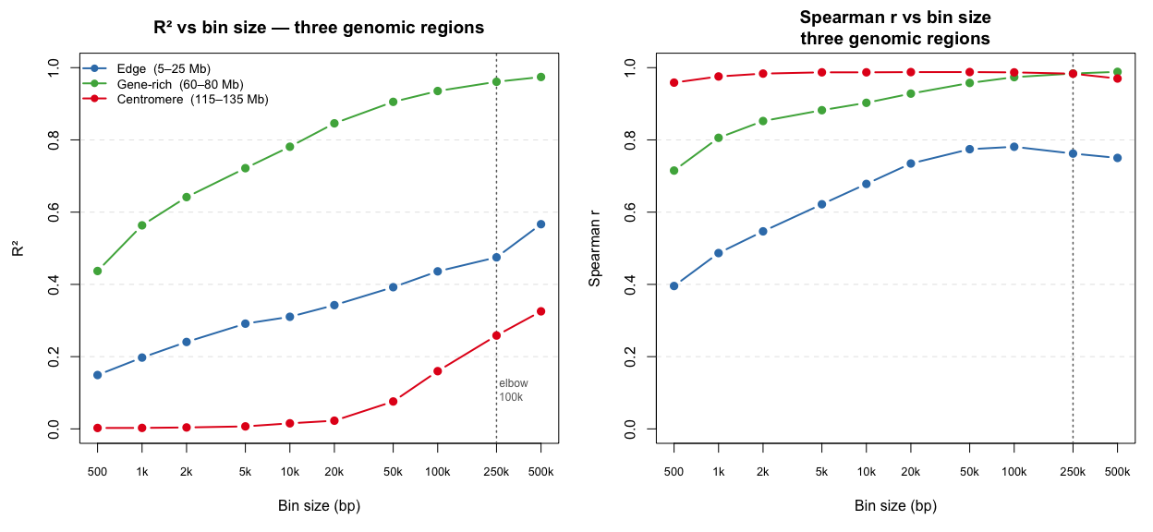
C. Optimal bin size for model
Shiny App Port Link
Notes:
To run, follow these instructions:
One-time setup (if on a new machine):
cd /path/to/StatisticsLab
git pull
Rscript -e "install.packages(c('shiny','data.table','splines','plotly'), repos='https://cloud.r-project.org')"
Every time you want to run it:
cd /Users/idoravid/Documents/Studies/Stat\ Lab/StatisticsLab
Rscript -e "shiny::runApp('lab5/shiny_app')"
Then open http://127.0.0.1:3838 in your browser.
Expected startup output:
[1/6] Reading reads file...
[2/6] Loading chromosome sequence...
[3/6] Loading precomputed cache... ← instant, no recomputing
-> cache loaded instantly!
[6/6] All precomputation done — app ready!
Listening on http://127.0.0.1:3838
To stop it: Ctrl+C in the terminal.

Slide 9
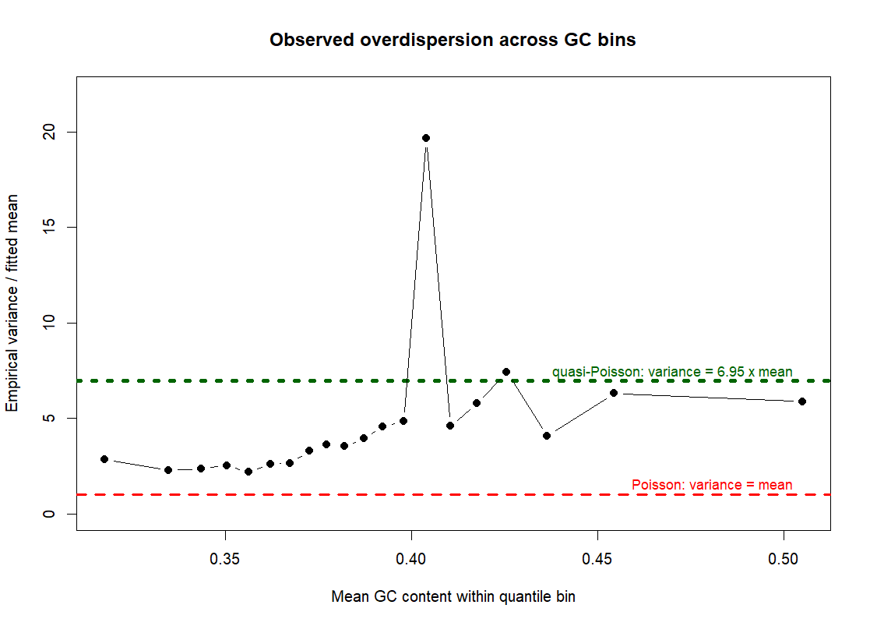
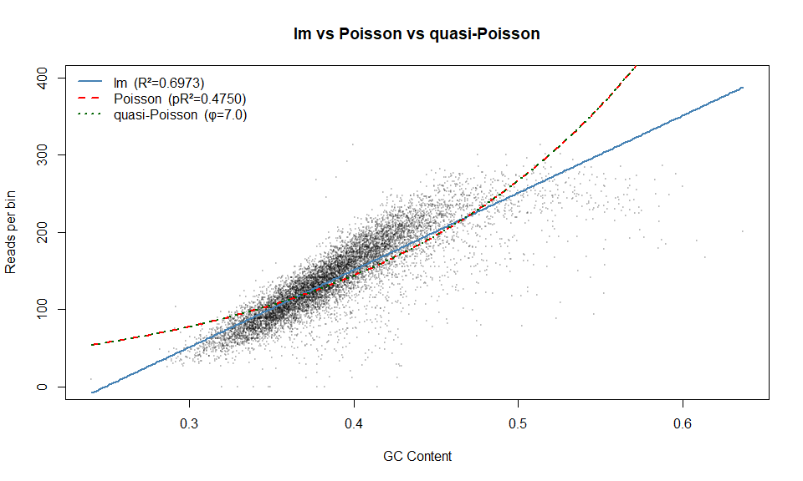
D. Poisson and Pseudo-Poisson GLM models
Notes:
To run, follow these instructions:
One-time setup (if on a new machine):
cd /path/to/StatisticsLab
git pull
Rscript -e "install.packages(c('shiny','data.table','splines','plotly'), repos='https://cloud.r-project.org')"
Every time you want to run it:
cd /Users/idoravid/Documents/Studies/Stat\ Lab/StatisticsLab
Rscript -e "shiny::runApp('lab5/shiny_app')"
Then open http://127.0.0.1:3838 in your browser.
Expected startup output:
[1/6] Reading reads file...
[2/6] Loading chromosome sequence...
[3/6] Loading precomputed cache... ← instant, no recomputing
-> cache loaded instantly!
[6/6] All precomputation done — app ready!
Listening on http://127.0.0.1:3838
To stop it: Ctrl+C in the terminal.

Slide 10
E. AI First Approach
Your coefficient idea is better.
How we used AI:
Planning
Implementing - shiny app
Analysing
Pros:
Better decisions driven by expertise (statistics, biology)
Creative ideas we didn’t think of
Cons:
Bad at visualizing
Less familiarity with codebase
Expensive
Fit quality metric: use R^2 for linear models and McFadden’s pseudo-R^2 for Poisson - allows apples -to-apples comparison across all questions.
Totel code changes: 2322 lines added, 881 lines removed
Usage by model:
Claude-haiku-4-5: 10.6k input, 49.4k output, 7.4m cache read, 476.4k cache write
Claude-sonnet-4-6: 5.5k input, 166.3k output, 18.2m cache read, 1.4m cache write

Slide 11
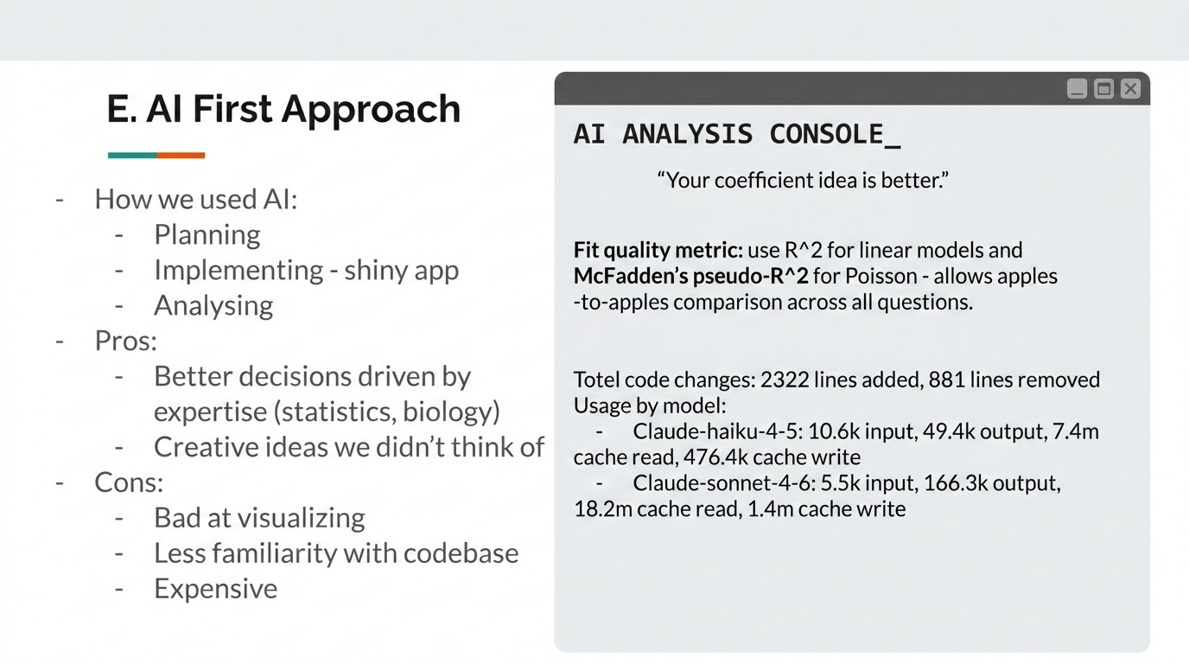

Slide 12
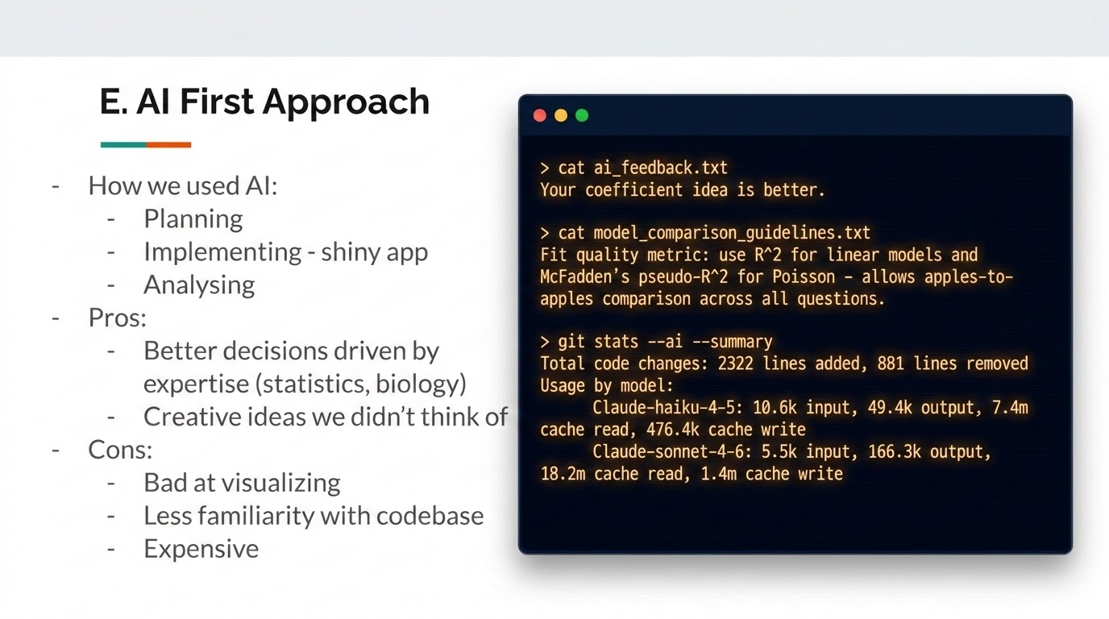

Slide 13
E. AI First Approach
How we used AI:
Planning
Implementing - shiny app
Analysing
Pros:
Better decisions driven by expertise (statistics, biology)
Creative ideas we didn’t think of
Cons:
Bad at visualizing
Less familiarity with codebase
Expensive

